Slide 1

CSE 2213 · 3 CREDITS · DEPARTMENT OF CSE
Discrete Mathematics
Lecture 1 · Introduction to the course
Masnoon Muztahid
Lecturer, Department of CSE
United International University

Slide 2
HELLO, EVERYONE
Your instructor
Masnoon Muztahid
Email masnoon@cse.uiu.ac.bd
Phone 01999977523
How we will stay in touch
eLMS — slides, assignments, announcements
UCAM — all marks and attendance
Class representative — day-to-day coordination
Email — anything personal or detailed
Phone — emergencies only, please
Questions are always welcome — during class, after class, or by email. A question you ask today saves you an hour tonight.
Masnoon Muztahid · Lecturer, Dept. of CSE, UIU · CSE 2213
2

Slide 3
THE BIG PICTURE
Where this course sits in your degree
Intro to
Computing Systems
Structured
Programming
Data Structures
& Algorithms I
Object Oriented
Programming
Data Structures
& Algorithms II
Discrete
Mathematics
▲ We are here
Almost everything you will build later — algorithms, databases, networks, AI — rests on the ideas of this one course.
Weak foundation here means a hard time in every course that follows.
Masnoon Muztahid · Lecturer, Dept. of CSE, UIU · CSE 2213
3

Slide 4
DEFINITION
So, what is Discrete Mathematics?
The mathematics of things you can count and separate — whole numbers, objects, steps, states, choices.
DISCRETE
CONTINUOUS
separate, countable points
unbroken, flowing values
1, 2, 3 … students, bits, nodes, moves
speed, temperature, voltage — that is Calculus
A computer has no continuous values. Memory is bits, time is clock ticks, a program is a finite list of steps. So computer science is discrete.
Masnoon Muztahid · Lecturer, Dept. of CSE, UIU · CSE 2213
4

Slide 5
FIVE THEMES
Goals of this course
A discrete mathematics course is not a list of facts to memorise. Its real goal is to teach you to think logically and mathematically. Five themes run through it.
1
Mathematical reasoning
Read, understand and build a correct mathematical argument
Logic · Proof techniques
2
Combinatorial analysis
Count and enumerate objects without listing them one by one
Counting · Permutations
3
Discrete structures
Work with the structures that model objects and their relationships
Sets · Functions · Graphs · Trees
4
Algorithmic thinking
Specify an algorithm, show that it is correct, measure what it costs
Algorithms · Complexity
5
Applications and modelling
Turn a real problem into a discrete model and then solve it
Every chapter
Masnoon Muztahid · Lecturer, Dept. of CSE, UIU · CSE 2213
5

Slide 6
MOTIVATION
Why should you care?
Algorithms
Prove your code is correct —
and count how slow it is
Databases
SQL is set theory and
logic wearing a costume
Cryptography
Your password, OTP and HTTPS
are number theory
AI & Machine Learning
Probability, counting and
logical inference
Networks & Maps
Shortest route, routing tables,
social graphs
Digital Logic
Every circuit in a CPU is a
logical expression
Every one of these is a later course. Today you start the toolbox they all borrow from.
Masnoon Muztahid · Lecturer, Dept. of CSE, UIU · CSE 2213
6

Slide 7
QUESTIONS THIS COURSE ANSWERS
The kinds of problems it solves
How many ways are there to choose a valid password on a computer system?
Counting & permutations
What is the probability of winning a lottery?
Discrete probability
How can I encrypt a message so that no unintended recipient can read it?
Number theory & cryptography
What is the shortest path between two cities using a transportation system?
Graphs & shortest paths
How can a list of integers be sorted so that the integers are in increasing order?
Algorithms
How many steps are required to do such a sorting?
Algorithm complexity
How can it be proved that a sorting algorithm correctly sorts a list?
Proof techniques
Masnoon Muztahid · Lecturer, Dept. of CSE, UIU · CSE 2213
7

Slide 8
COURSE ROADMAP
What we will cover
Before the Mid-term
Before the Final
CO 1 · 2 · 3
CO 4 · 5
Propositional Logic
3 classes
The Basics of Counting
1 class
Predicates & Quantifiers
2 classes
Pigeonhole Principle
1 class
Proof Techniques
2 classes
Permutations & Combinations
1 class
Sets & Set Operations
2 classes
Recurrence Relations
1 class
Functions
1 class
Graphs & Graph Models
4 classes
Mathematical Induction
1 class
Trees & their Applications
3 classes
Everything builds on everything. Miss a week and the next week costs you double.
Masnoon Muztahid · Lecturer, Dept. of CSE, UIU · CSE 2213
8

Slide 9
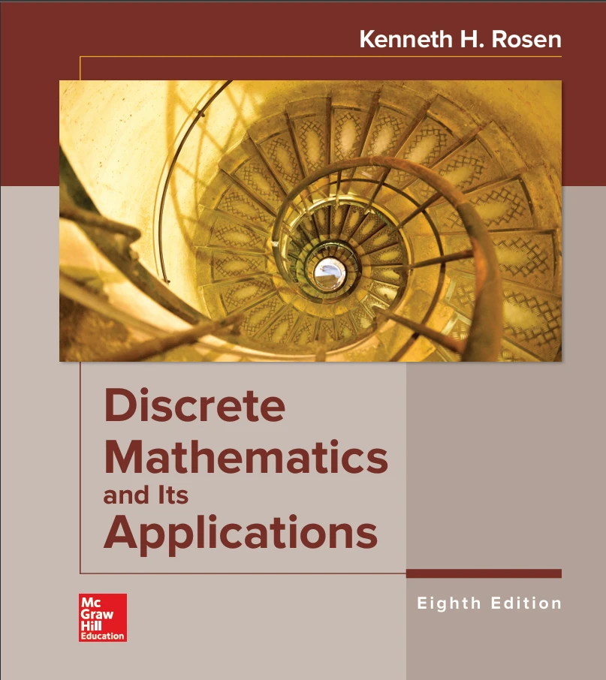
READING
Our textbook
Discrete Mathematics and Its Applications
Kenneth H. Rosen · 8th Edition · McGraw-Hill
Every topic in this course maps to a chapter of this book
Read the section before the class — even skimming helps
The Examples are worked out step by step — copy that in exams
The Exercises at the end of each section are your practice set
Today: Section 1.1 — Propositional Logic
Masnoon Muztahid · Lecturer, Dept. of CSE, UIU · CSE 2213
9

Slide 10
ASSESSMENT
Marks distribution
Attendance
5%
Central UIU attendance policy
Assignments
5%
Average of the assignments given
100
marks
in total
Class Tests
20%
Best 3 out of minimum 4 class tests
Mid-term Exam
30%
Covers CO 1, 2, 3
Final Exam
40%
Covers CO 4, 5
60 of the 100 marks are earned before the final exam — start in week one.
Masnoon Muztahid · Lecturer, Dept. of CSE, UIU · CSE 2213
10

Slide 11
ASSESSMENT
Grading policy
A
90 – 100 marks
B-
74 – 77 marks
D+
58 – 61 marks
Grade point 4.00
Grade point 2.67
Grade point 1.33
A-
86 – 89 marks
C+
70 – 73 marks
D
55 – 57 marks
Grade point 3.67
Grade point 2.33
Grade point 1.00
B+
82 – 85 marks
C
66 – 69 marks
F
below 55 marks
Grade point 3.33
Grade point 2.00
Grade point 0.00
B
78 – 81 marks
C-
62 – 65 marks
Grade point 3.00
Grade point 1.67
A grade is a by-product, not the goal. Chase the understanding and the grade follows.
Target the A: it is only 4 marks away from A- , and those 4 marks usually come from class tests.
Masnoon Muztahid · Lecturer, Dept. of CSE, UIU · CSE 2213
11

Slide 12
FIVE HONEST TIPS
How to do well in this course
1
Attend and stay awake
Discrete math is a chain of ideas. One missing link breaks the rest.
2
Solve with a pen
Reading a solution feels like learning. It is not. Write it yourself.
3
Do Rosen's exercises
Exam questions are the same species as the book's exercises.
4
Ask the stupid question
It is never stupid, and half the room wanted to ask it.
5
Never memorise a proof
Understand the idea; the lines will write themselves.
Masnoon Muztahid · Lecturer, Dept. of CSE, UIU · CSE 2213
12

Slide 13
Let’s begin.
Section 1.1 — Propositional Logic
Masnoon Muztahid · Lecturer, Dept. of CSE, UIU · CSE 2213
13

